Slide 1


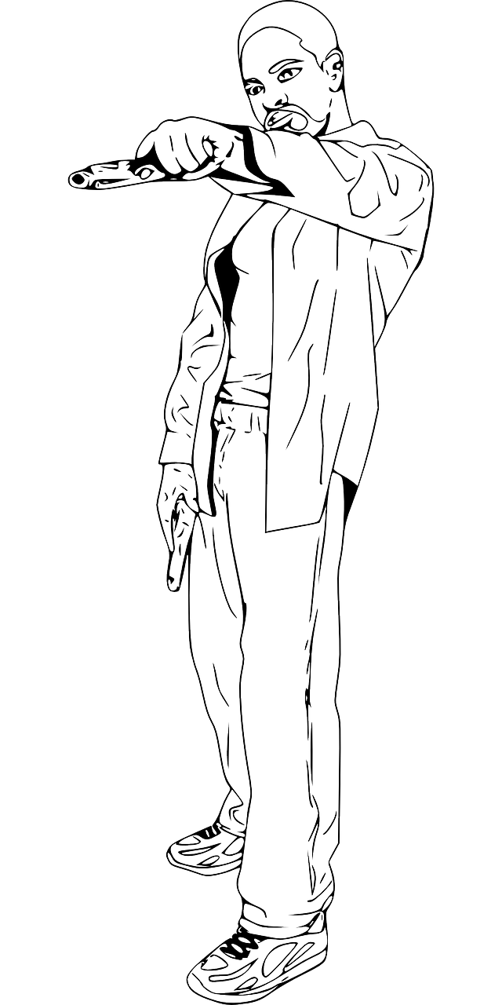

Chicago violent crime rates have been in the news lately and none of these news were good. Both national and local news outlets have published numerous articles highlighting the alarmingly high numbers of violent crimes in the city. In preparation to the upcoming meeting with a very well-known real estate developer, I will to provide honest, unbiased assessment of Chicago crime rates. This is my opportunity to tell how dangerous (or not) Chicago has become in the last year. You may want to consider highlighting some of the following: The Problem: • What are the historical Chicago crime trends? o How these trends compare with other large cities? o Is there a seasonality aspect in the crime rates? o Are there certain seasons / times of the day that are particularly affected? o Do you see all crime rates growing in Chicago, or just certain types of crime? Hypotheses: The Chicago historical crime trend is positive.

Slide 2
The Problem: How does the Chicago crime rates compare between major US cities (overall as well as per capita)?
Hypotheses: Chicago crime rates is higher than crime rate between major US cities.

Slide 3
The Problem: What is Primary Type Chicago crime?
Hypotheses: We should make profile Primary Type Chicago crime

Slide 4
Data sources :
Table of United States cities by crime rate
https://en.wikipedia.org/wiki/List_of_United_States_cities_by_crime_rate_%282014%29
The following datasets can be downloaded directly from the source:
• Chicago Crimes - 2001 to present
http://catalog.data.gov/dataset/crimes-2001-to-present-398a4
Crimes_-_2001_to_present.csv
• Baton Rouge Crime Incidents
http://catalog.data.gov/dataset/baton-rouge-crime-incidents • Honolulu Crime Incidents
http://catalog.data.gov/dataset/crime-incidents-a7479
• New Orleans Calls for Service 2016 and 2017.csv o https://catalog.data.gov/dataset/calls-for-service-2016
https://catalog.data.gov/dataset/calls-for-service-2017
• SFPD Incidents - from 1 January 2003.csv
http://catalog.data.gov/dataset/sfpd-incidents-from-1-january-2014

